Slide 1



Avian Hazard Advisory System (AHAS)

Slide 2
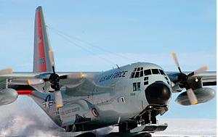
Avian Hazard Advisory System: AHAS
  Briefing Objectives
  Background
  System Components
  Risk Calculations
  AHAS Queries
  Best Practices
  Common Misconceptions

Slide 3
AHAS
  BACKGROUND
      1985 – 2005 25% of all reported bird strikes (USAF) were on LL Routes/Ranges
      1987 loss of B-1b (Dyess) renewed concerns on bird avoidance
      Bird Avoidance Models (BAM)
      GIS technology (1990’s)
      Nationwide system of radars that could “detect” biological targets in atmosphere
      Affordable computer systems
      INTERNET distribution capability
      1998 - AHAS pilot program

Slide 4
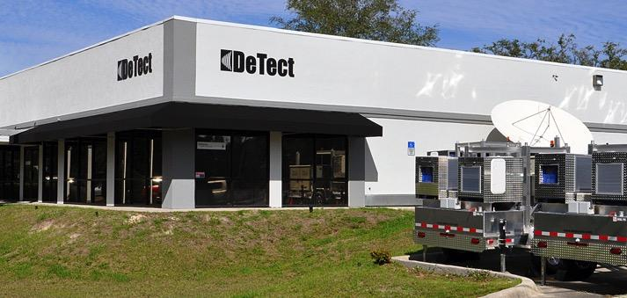

AHAS
  System Components
      WSR 88-D (NEXRAD)
      Soaring Forecast Models
      Bird Avoidance Model Layer
      Risk calculation algorithms
      Display options (.com website)

Slide 5
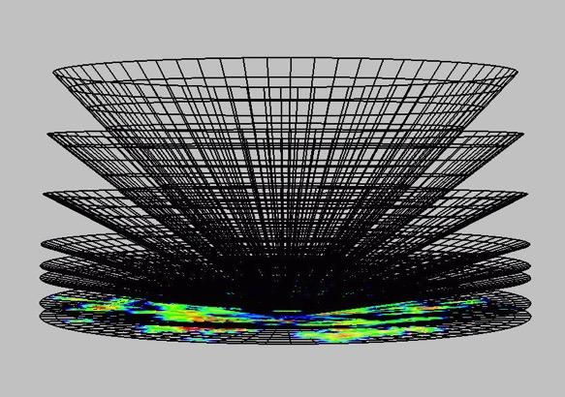
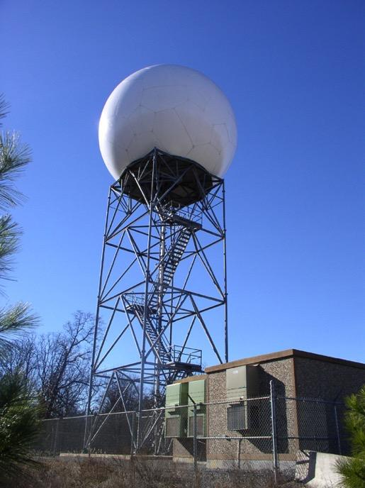
AHAS
  System Components
      WSR 88-D (NEXRAD)
S-Band Weather Radar (Doppler)
  10 cm wave length
  2700-2900 MHz
1 degree beam
Level II dual polarization
Updates every 4-10 minutes
Clutter suppression algorithms
Point target suppression

Slide 6
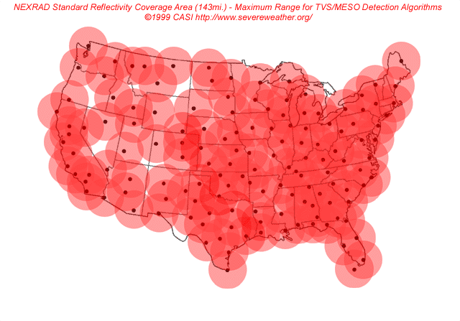
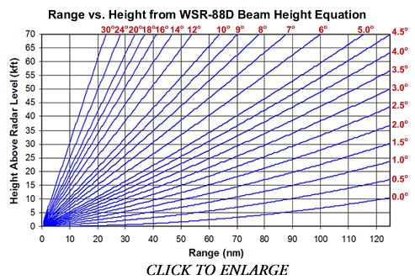
AHAS
  System Components
      WSR 88-D (NEXRAD)

Slide 7
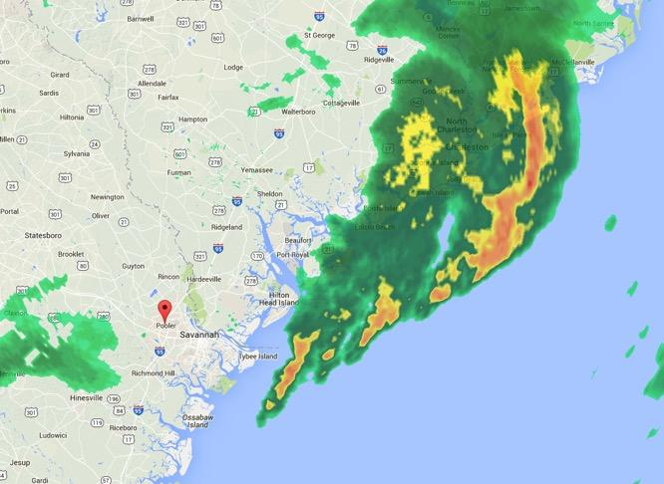
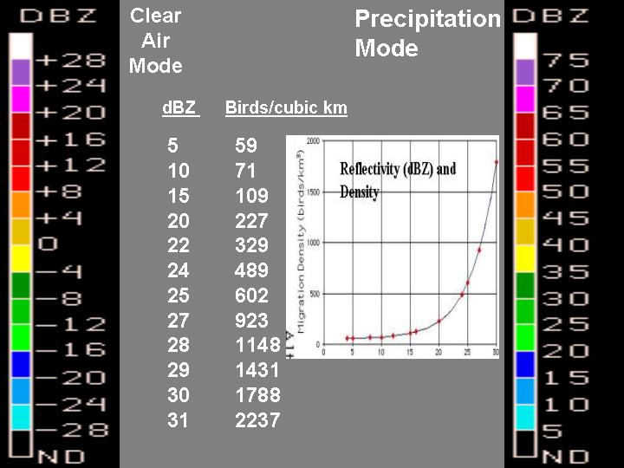
AHAS
  System Components
      WSR 88-D (NEXRAD)

Slide 8
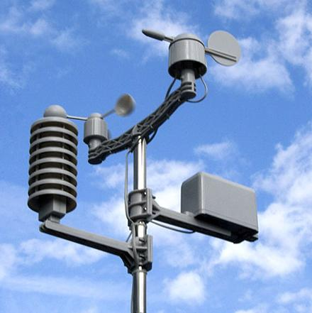

AHAS
  System Components
      Soaring forecast
        Model Output Statistics (MOS)
        Upper Air (UPA)
        Thermal Depth
        Soaring Bird Activity

Slide 9

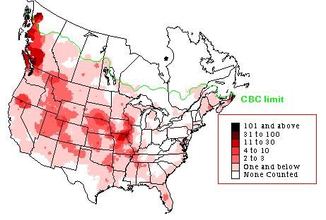

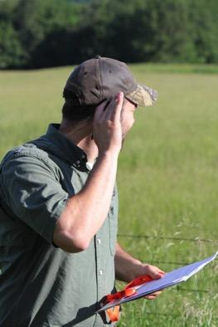
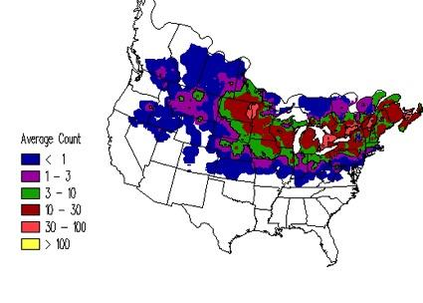
AHAS
  System Components
      Bird Avoidance Model (BAM) Layer
        Christmas Bird Counts (CBC)
        Breeding Bird Surveys (BBS)
        Refuge Data sets (State and Federal)
        Land use attractions
          Landfills
          Refuges
          Lakes

Slide 10
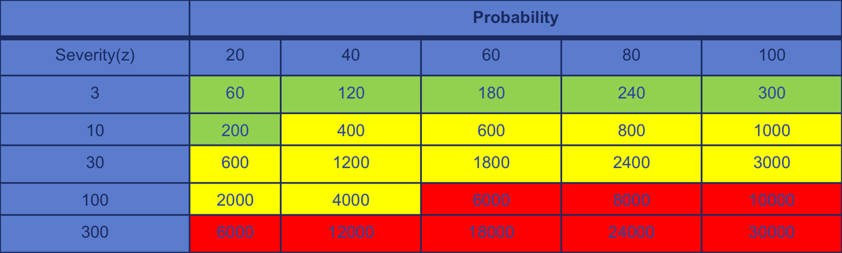
AHAS
  Risk Calculations
      Operational Risk Methodology
      Probability is a function of the percentage of pixels with radar returns within any risk polygon (MOA, Route Segment, Airfield)
      Severity of outcome is a function of the average reflectivity values within the risk polygon (generally the higher the reflectivity values, the great the biomass in that area of airspace)

Slide 11
AHAS
      Integrating Model Components
AHAS
NEXRAD or
WSR-88D
Soaring Risk Model
Bird Avoidance Model (BAM)
Near real-time weather radar
US Weather Service Data
Christmas Bird Count
Breeding Bird Surveys
Migratory Bird Routes

Slide 12
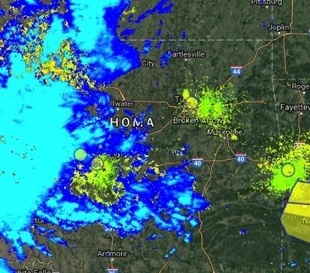
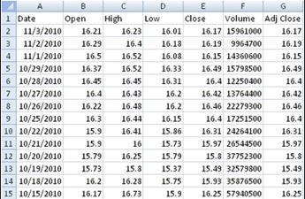


AHAS
  Queries
      Near Real Time
        Risk calculation based on radar returns
      Within next 24 Hours
        Risk calculation based on soaring forecast algorithms and BAM distributions
      Future Operations (beyond 24 hours)
        Risk calculation based on BAM layer distributions only

Slide 13
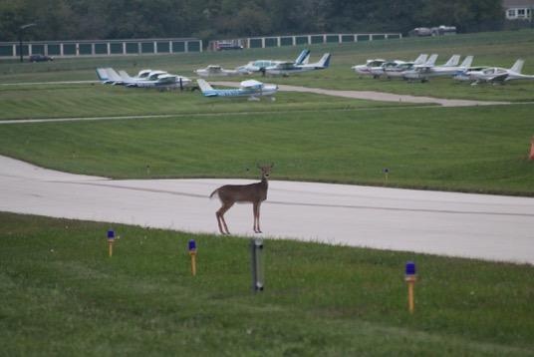
AHAS
  Common Misconceptions
    Looking “back” at previous time intervals beyond last month does NOT bring up radar-based advisories……only the BAM information
    AHAS advisory conditions for past dates are available upon request from AHAS contractor (mishap investigations)
    Using AHAS for BWC should only be one tool in the box, and is not recommended to be used solely to determine BWC (beam height, update rate, and point target suppression)
    NEXRAD data are NOT used for forecast algorithms

Slide 14
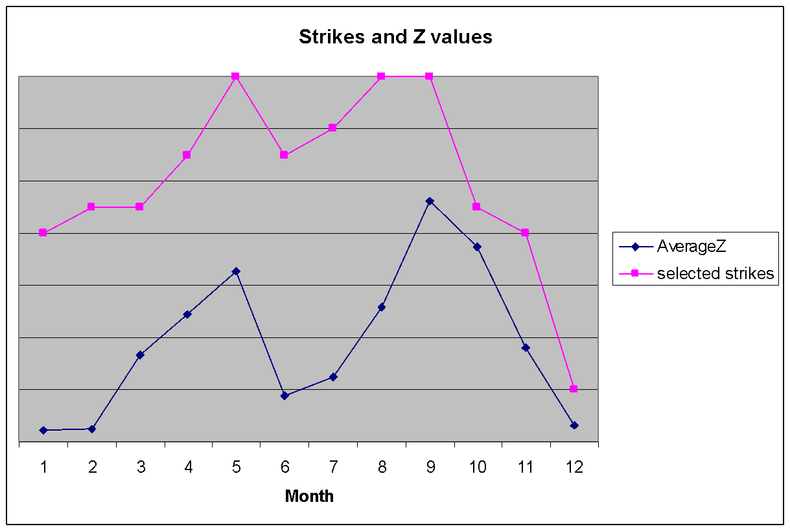
AHAS
  Common Misconceptions
    I don’t see anything……………..
Average Reflectivity
And Reported bird strikes
Columbus AFB, MS

Slide 15
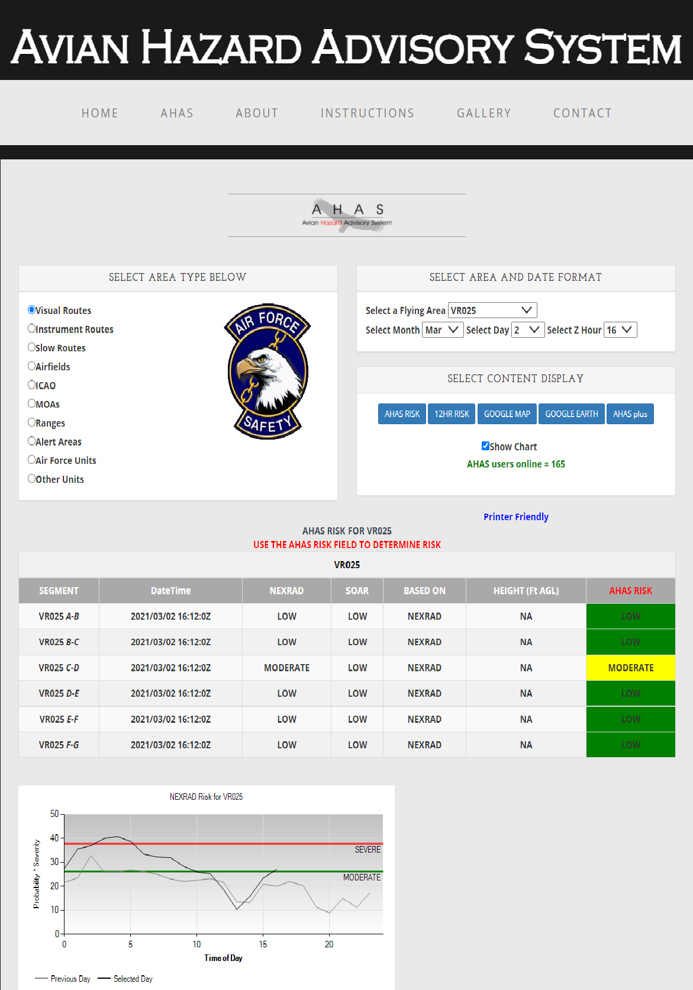
  Table Query

Slide 16
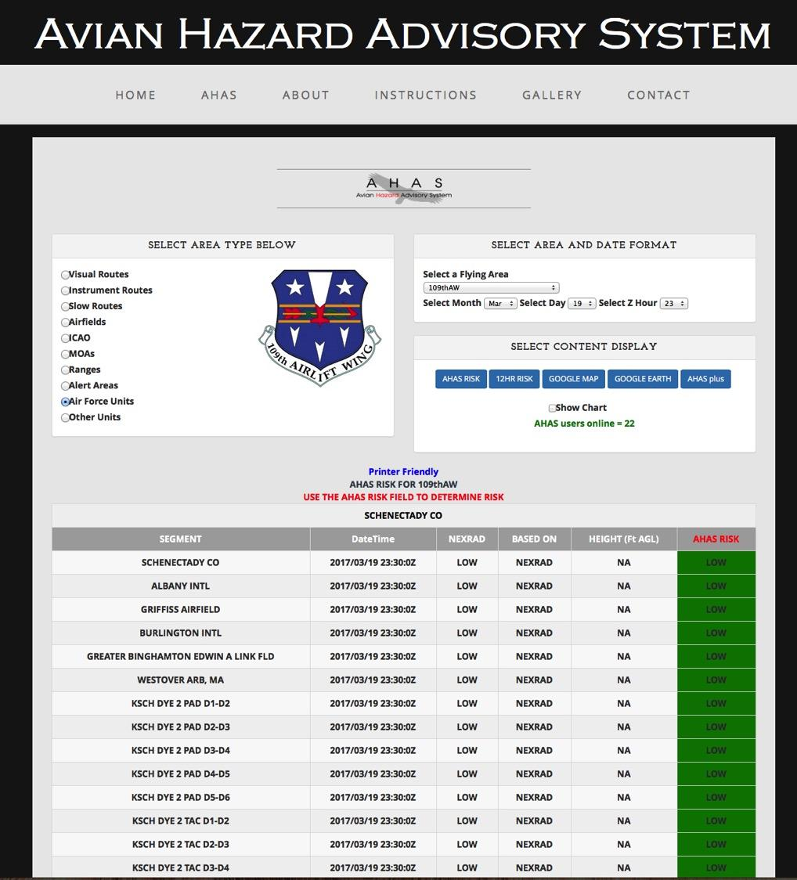
  Unit Page

Slide 17
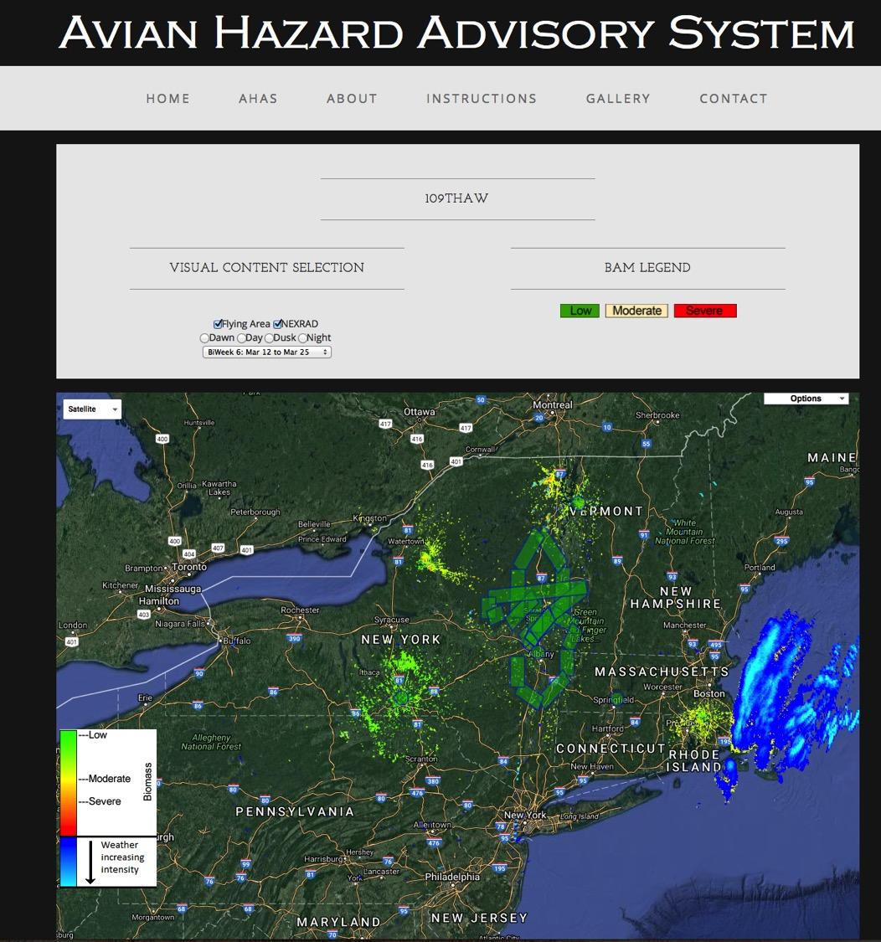
  Google Maps/Earth

Slide 18
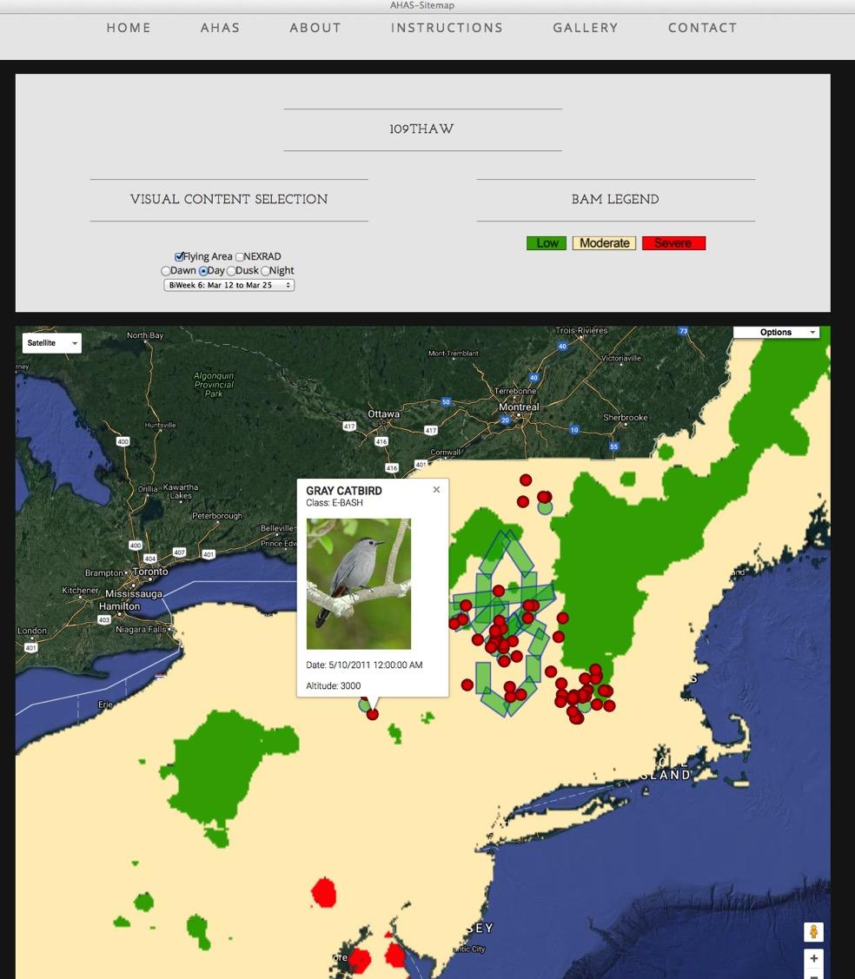
  AHAS BAM Layer

Slide 19
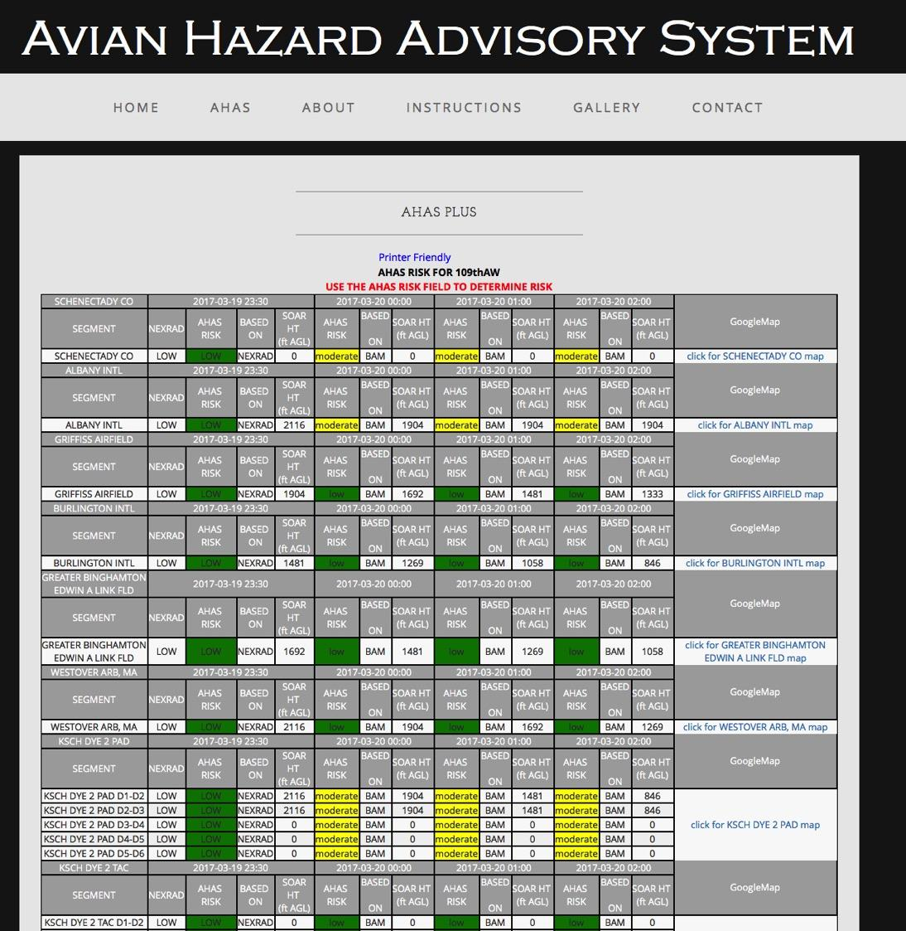
  AHAS Plus

Slide 20
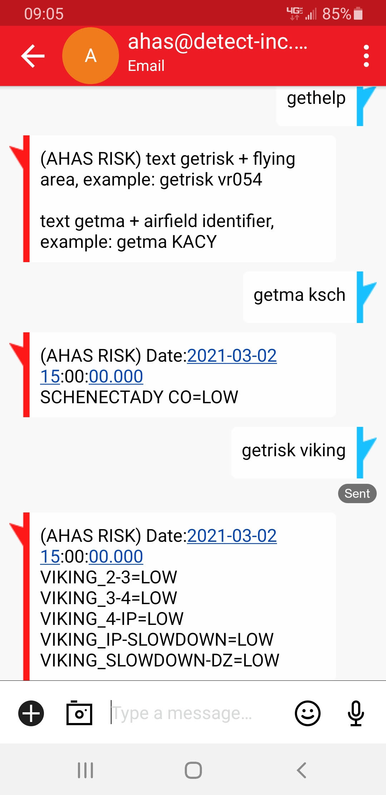
  AHAS Messenger ahas@detect-inc.com

Slide 21
AHAS
  Best Practices and other stuff you should know
      Establish a unit page to consolidate airspace options
      Check AHAS during mission planning
      Check AHAS during “the step” (SOF briefing or at ops desk)
      If available, check in with range operations for AHAS update enroute
      If possible check route with AHAS messenger
      AHAS may queue operations staff about bird activity in the vicinity of the airport as PART of establishing Bird Watch Condition Codes (BWC), but must not replace other airfield observations!
      AHAS “system” operated under contract, monitors all “hits” on the system and keeps records of queries.

Slide 22
CONTACT INFORMATION
USAF BASH Team
  Mr. Dan Sullivan, Branch Chief daniel.sullivan.26@us.af.mil, DSN 246-5674
  Commercial prefix is (505) 846-xxxx
AHAS Personnel
  Mr. Ron White
  ahas@detect-inc.com
  850-763-7200

